Slide 1
Process Map:
MORTGAGE LOAN PROCESS MAPPING & IMPROVEMENT

Slide 2
Process Mapping – Commonly Used UML Symbols
Decision Point
Data
Start and End Process
Process Step
Manual Operation
Decision Point
Process Step
Yes
Manual Operation
Symbols are connected to show flow, like this:
No
Process Step

Slide 3
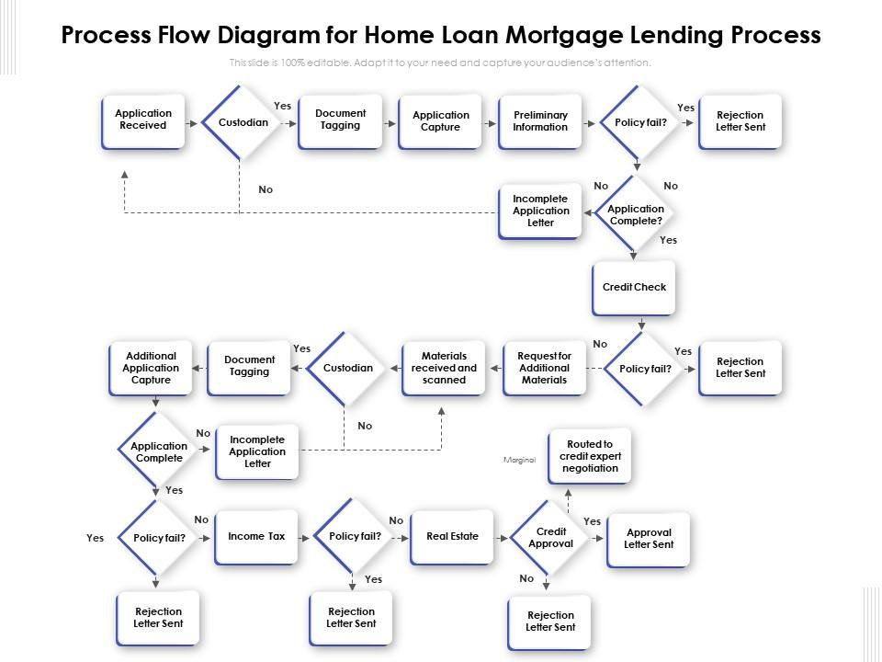
Process Map: Loan Originating Process

Slide 4
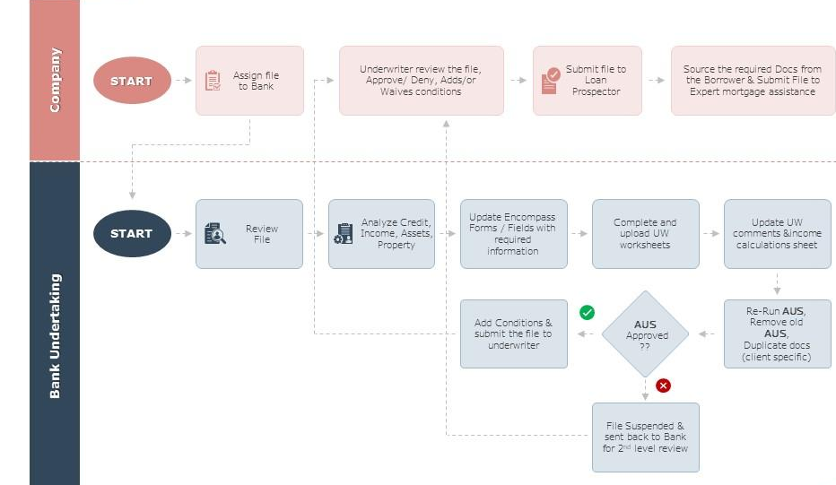
Process Map: Loan Underwriting Process

Slide 5
Process Map: Opportunities for Originating Process Improvement
Automation: Identify areas within the process that can be automated to reduce manual effort and improve efficiency.
Integration with External Systems: Integrate the mortgage loan origination system with external systems, such as credit bureaus, property valuation services, and income verification platforms.
Customer Experience Focus: Place a strong emphasis on improving the overall customer experience during the origination process.

